Slide 2
Explore your ceativity
Dear Students
Make a 2D
( on paper ) or 3D (Model with waste material available at home) Place Value chart showing Periods, Places and Place Values.

Slide 3
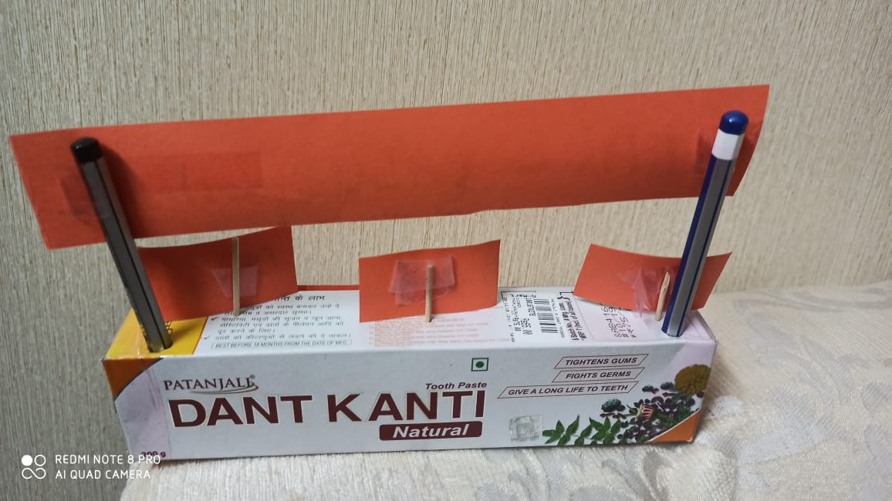

Slide 4
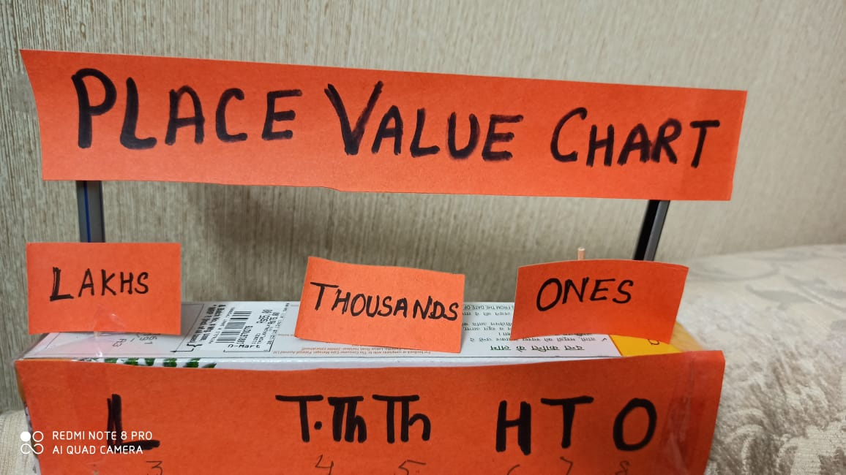

Slide 5
Perform the following Activities
1.Forming Numbers
The fun filled activity “Forming Numbers” will be played with Family members where students will practice to read large numbers.
Material Required: 6 Blank cards of same colour
Arrange the family members in a group of 6.( if you don’t have six members at home then divide the group accordingly)
First group will take out six blank cards and write a digit on each card.
Then place the six cards in front of next group members.
The other group members will write the numeral and number name in the
notebooks.
The process will continue till the last group.
Whoever completes the maximum numbers will be the winner.

Slide 6
2. Prepare a following chart in your notebook showing atleast one work ( daily ) in which you help your parents.i.e.
Time of the day in words | Time on the clock | What do you do at this time?
Half Past 9 | 9:30 a.m. | Helping mother in serving breakfast.

Slide 7
Tease your brain

Slide 8
MATHS
QUIZ
FOR CLASS - IV

Slide 9
Q1. What is the greatest 5 digit number?

Slide 10
Q2. The numeral for Eight lakh nine thousand seven hundred twenty nine is -----

Slide 11
Q3. 30,000 +2,000+900 +0+4=____

Slide 12
Q4.The Place Value of 9 in 4,95,203 is_____.

Slide 13
Q5.Number name of 1,00,203is _____

Slide 14
Q6. How many hundreds make one thousand?

Slide 15
Q7. What is the period of 3 in 3,40,951?

Slide 16
Q8. What is the successor of smallest 5-digit number?

Slide 17
Q9. What is the smallest 5-digit number formed by using the digits 4,2,0,5,9 at once ?

Slide 18
Q10.Which one is greater?
3,45,906 or 3,54,906

Slide 19
Time to Assess yourself Answers 1. . 99,999 2. 8,09,729 3. 32,904 4. 9 ten thousands 5. One lakh two hundred three 6. 10 hundreds 7. Lakhs 8. 10,001 9. 20,459 10. 3,54,906

Slide 20
How many correct answers did you get ?
YOUR SCORE | RESULT
LESS THAN 5 | AVERAGE
6 TO 8 | GOOD
MORE THAN 8 | VERY GOOD

Slide 21
THANK YOU

